Slide 1

Paper Review: New Consensus Protocol
Proof of Luck: an Efficient
Blockchain Consensus Protocol
https://youtu.be/m5Ke-R8d7Cc

Slide 2
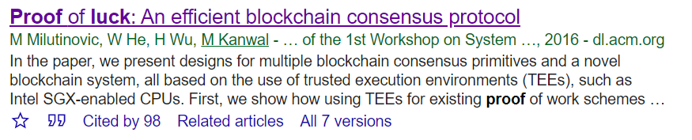

Slide 3


Bitcoin
Blockchain System
Cryptocurrency
Distributed Ledger
Mutual Distrust Participants
Require Consensus Algorithm
→ Proof of Work
1 page

Slide 4
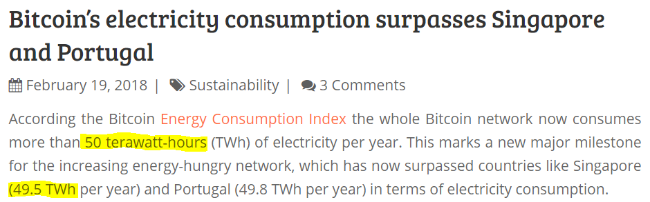
Proof of Work ( PoW )
Consensus Algorithms
Cons
High Cost ( time, energy )
Bitcoin’s PoW
Block time : 10 min
Confirm : after 6 blocks
https://digiconomist.net/bitcoin-electricity-consumption-surpasses-singapore-portugal
Uncle, Dividing Block
Proof of Stake, Proof of Burn
Decrease the Number of Forks
2 page

Slide 5

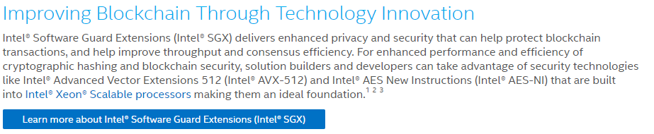
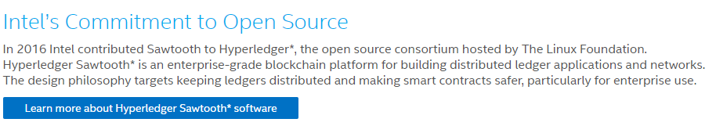
New Consensus Model Using TEEs
Trusted Execution Environments ( TEE )
Intel SGX
Pros
Enforce correct processing
Limit the effect of Sybils
Sybil Attack : Control multiple node
3 page
https://www.intel.com/content/www/us/en/security/blockchain-overview.html

Slide 6
Consensus
Quick and Deterministic transaction confirmations.
Energy efficient protocol.
Resistant to custom hardware. ( ASIC-resistant )
GPU | Mhash/s | ASICs | Mhash/s
Titan X | 1,980 | AntMiner S7 | 4,730,000
GTX 980 Ti | 4,500 | Avalon 6 | 3,500,000
GTX 960 Gaming 2GOC | 1,173
GTX 1080 | 2,048 | SP20 Jackson | 1,500,000
GTX 1060 | 1,800
http://wiki.hash.kr/index.php/%EC%97%90%EC%9D%B4%EC%8B%9D
4 page

Slide 7
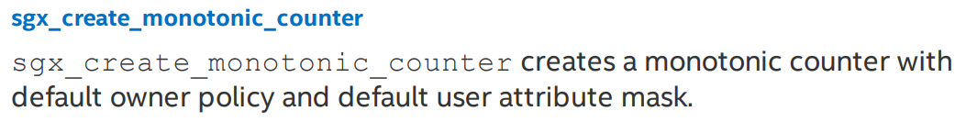
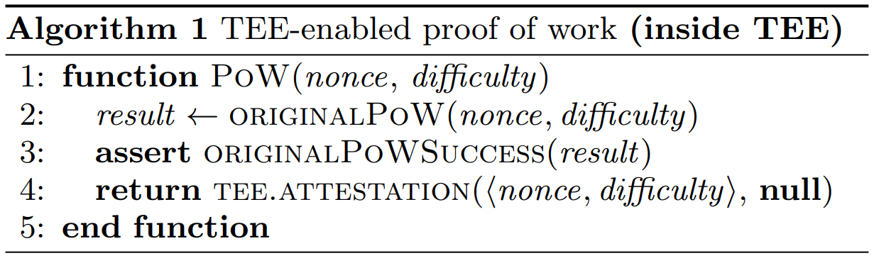
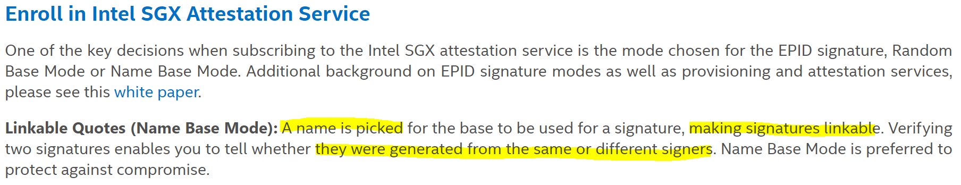
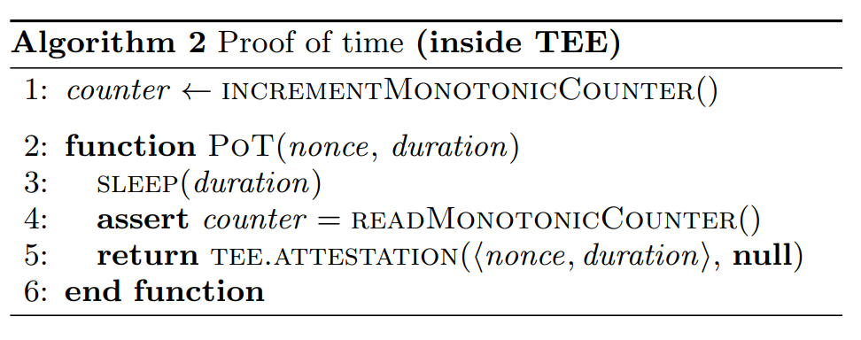
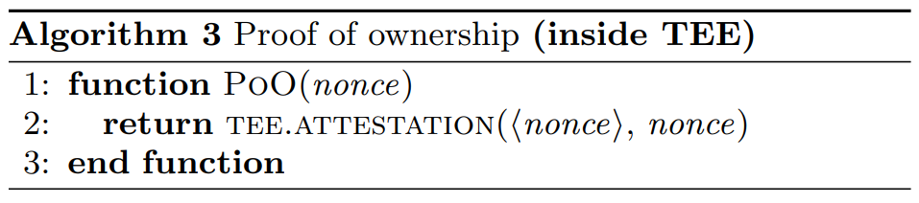
Proof of Work ( inside TEE )
Benefits
ASIC-resistant
Correct Process
Code ran in TEE
Code unmodified
Proof of Time ( inside TEE )
Benefits
Energy Efficiency
Desired Time
Sybil-resistant
Proof of Ownership ( inside TEE )
Benefits
Sybil-resistant
5 page

Slide 8
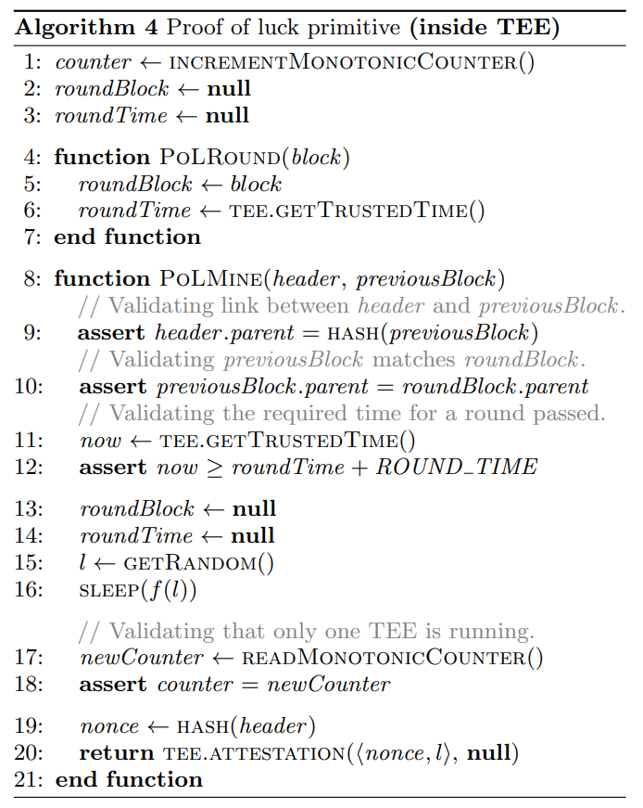
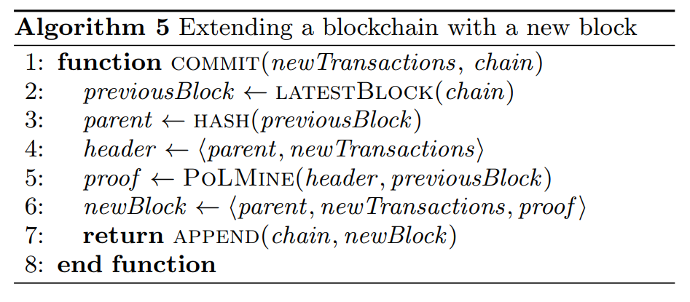
Proof of Luck ( inside TEE )
Currently known latest block
New Block’s
After ROUND_TIME
Ensure ROUND_TIME
[0, 1), from uniform distribution
Short delay for luckier, Long delay for unluckier
6 page

Slide 9
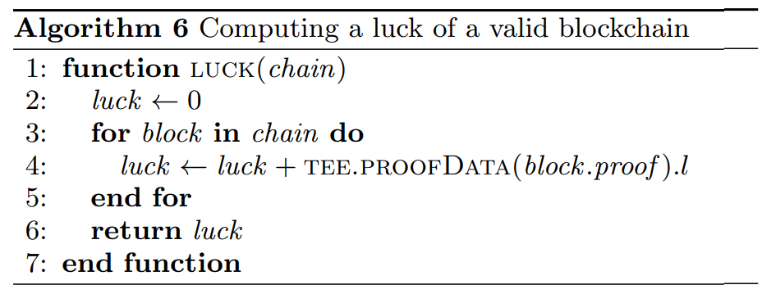
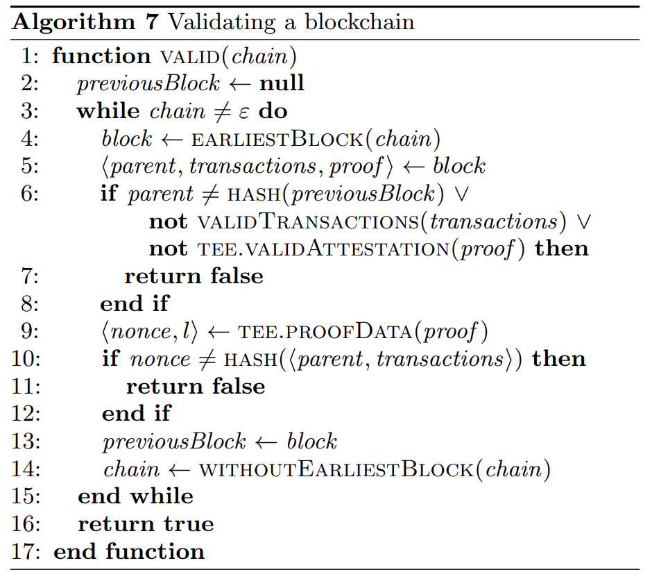
Proof of Luck ( inside TEE )
7 page

Slide 10
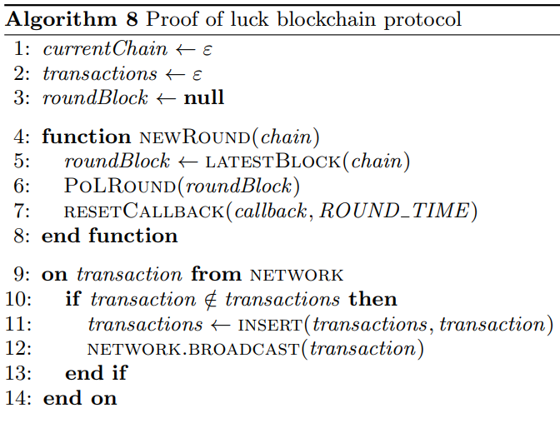
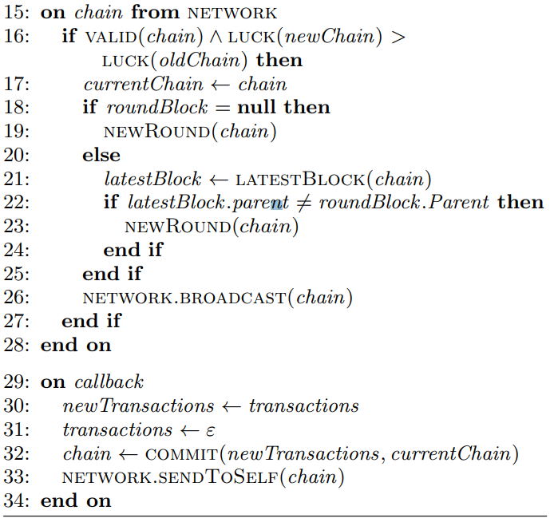
Proof of Luck Blockchain ( inside TEE )
8 page

Slide 11
Thanks
vexyoung@gmail.com

